Slide 1

Diamond deals
Unraveling the Metrics and Money in MLB Player Transactions
Hayden Ravert
Woz U

Slide 2
Background
Hayden Ravert
B.S. Astrophysics From Towson University
10 years of Retail Management
A lifetime of watching and analyzing Baseball

Slide 3
Project Question
What is the financial value of free agent players in Major League Baseball?

Slide 4
Determining A Players Value
Players Position
Pitcher vs. Position Player?
Player Statistics
Which statistics should we use?
Statistics vs. Salary
How do the stats influence salary?

Slide 5
Pitcher
Stats
ERA – Earned Run Average
Number of Runs per nine innings (Lower Better)
WHIP – Walks and Hits per Inning
How well a pitcher keeps players off base (Lower Better)
-IP – Innings Pitched
Number of innings pitched over a season (Higher Better)
-W – Wins
Pitcher of record with a lead after five innings when starting or most effective relief pitcher (Higher Better)
-SV – Saves
Pitcher who gets the last three outs with a lead of no more that three runs (Higher Better)

Slide 6
Position Players
Stats
H – Hits
When a player hits the ball in fair territory and reaches base (Higher Better)
RBI – Runs Batted In
When a player's plate appearance results in a run scored (Higher Better)
HR – Home Runs
When a player scores who hit the ball in fair territory (Higher Better)
AVG – Batting Average
Total Hits divided by Total At Bats (Higher Better)
OPS – On Base Percentage Plus Slugging
How well a hitter can reach base and how well he can hit for average and power (Higher Better)

Slide 7
WAR
Wins Above Replacement
Measures a player’s win value versus a replacement player at the same position(usually a Minor League replacement) (Higher Better)
WAR = (Batting Runs + Base Running Runs +Fielding Runs + Positional Adjustment + League Adjustment +Replacement Runs) / (Runs Per Win)
WAR = [[([(League “FIP” – “FIP”) / Pitcher Specific Runs Per Win] + Replacement Level) * (IP/9)] * Leverage Multiplier for Relievers] + League Correction

Slide 8
Gathering Data Methods
All data from spotrac.com
Free Agent Signings of seasons 2019-2023
Player, Position, Age, Bats, Throws, Team From, Team To, Years Signed, Total Salary, Average Yearly Salary
Stats of players from seasons 2018-2022
H, RBI, HR, AVG, OPS, IP, ERA, WHIP, W, SV, WAR
Starting with 679 Samples

Slide 9
Manipulating Data
Add Player Id column
Split the data into Pitcher and Position Player
Created dummy variables to match positions to separate
Drop irrelevant columns
Position, Bats, Throws, From, To
Drop missing values or change to 0
Pitchers
Age, Average Salary, Innings Pitched, ERA, WHIP, Wins, Saves, WAR
Sample Size 331
Position Players
Age, Average Salary, Hits, RBI, HR, AVG, OPS, WAR
Sample Size 278

Slide 10
Result Methods
Stepwise Exponential Regression
Method used to model the relationship between a dependent variable and one or more independent variables that adds or removes predictor variables from the model in a step-by-step fashion.
Mediation
Analysis used to explore the indirect effect of an independent variable on a dependent variable through a variable with a causal relationship.
Moderation
Analysis that examines the influence of a third variable on the strength or direction of the relationship between an independent variable and a dependent variable.

Slide 11
Results
Pitchers
Stepwise Regression Effects
IP: Not Significant
Interpretation of coefficients (Significance Highest to Lowest):
WAR: For each additional win above replacement, the average salary is estimated to increase by approximately $2,310,227.
W: For each additional win, the average salary is estimated to increase by approximately $533,834.
WHIP: For each additional walks plus hits per inning pitched, the average salary is estimated to decrease by approximately $5,699,905.
Intercept: The average predicted AVG. SALARY when all other variables are zero is $15,901,686
ERA: For each additional earned run average, the average salary is estimated to increase by approximately $724,465.
AGE: For each additional year in age, the average salary is estimated to decrease by approximately $284,546.
SV: For each additional save, the average salary is estimated to increase by approximately $93,039.
The adjusted R-squared for this model indicates that the included variables collectively explain about 53.82% of the variability in AVG. SALARY

Slide 12
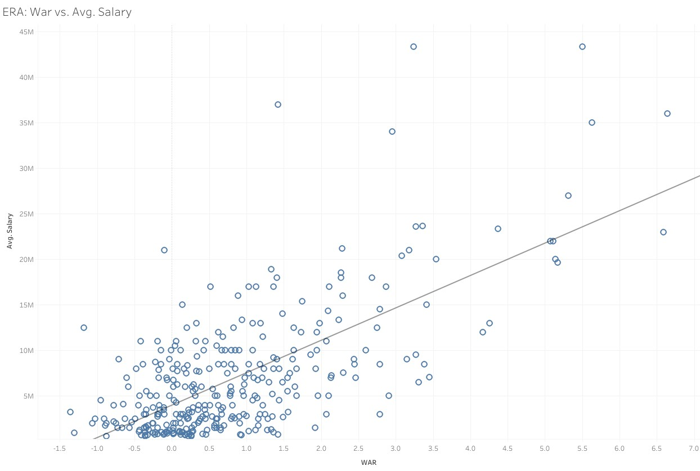
Results
Pitchers

Slide 13
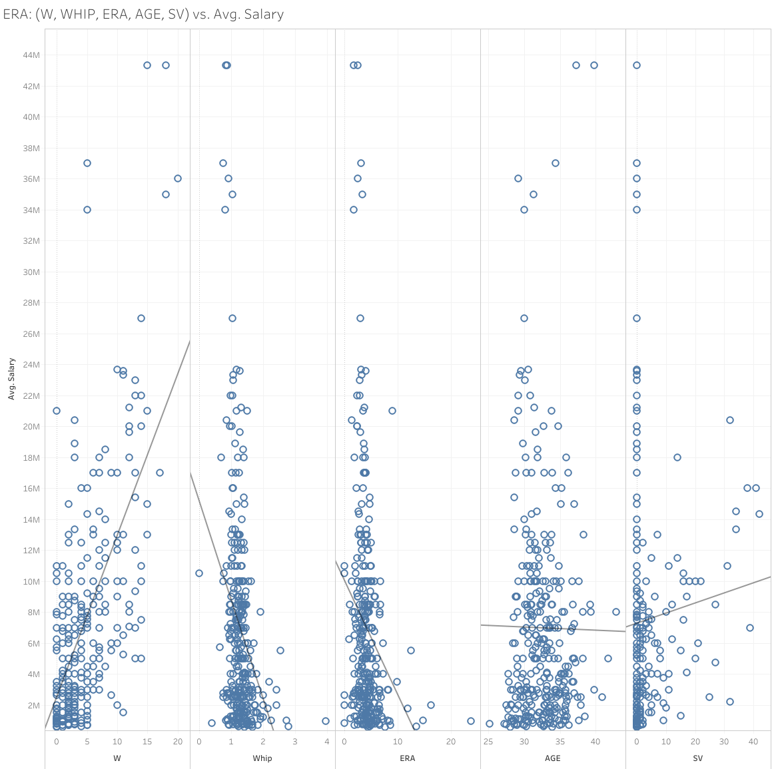

Slide 14
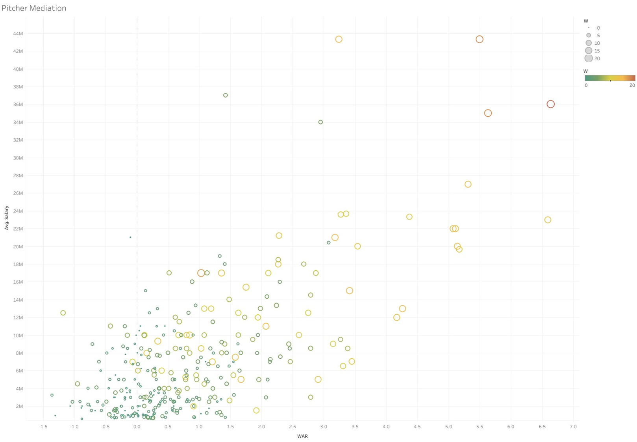
Mediation Analysis
Approximately 30% of the effect is mediated through W

Slide 15
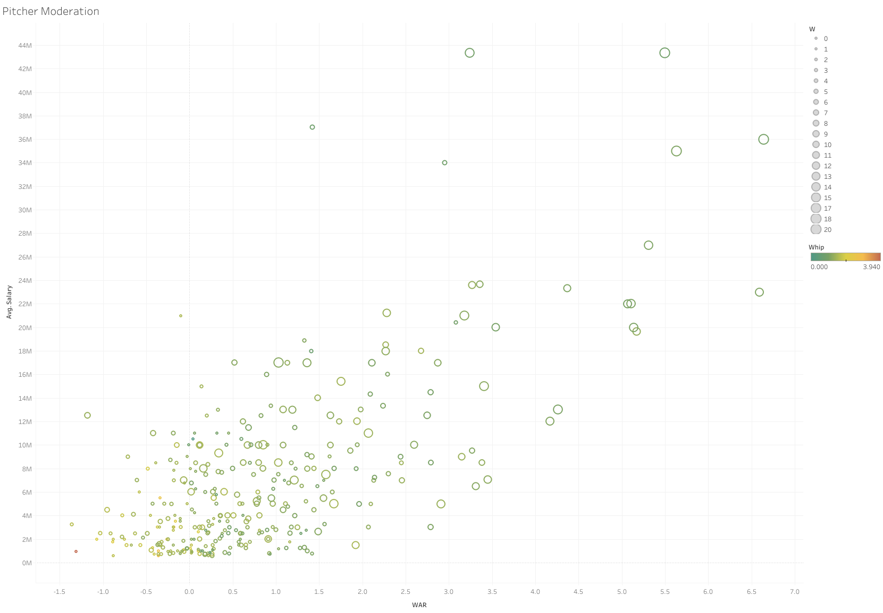
Moderation Analysis
WHIP 49.98%
W 51.93%
Moderate the relationships between WAR and AVG. SALARY

Slide 16
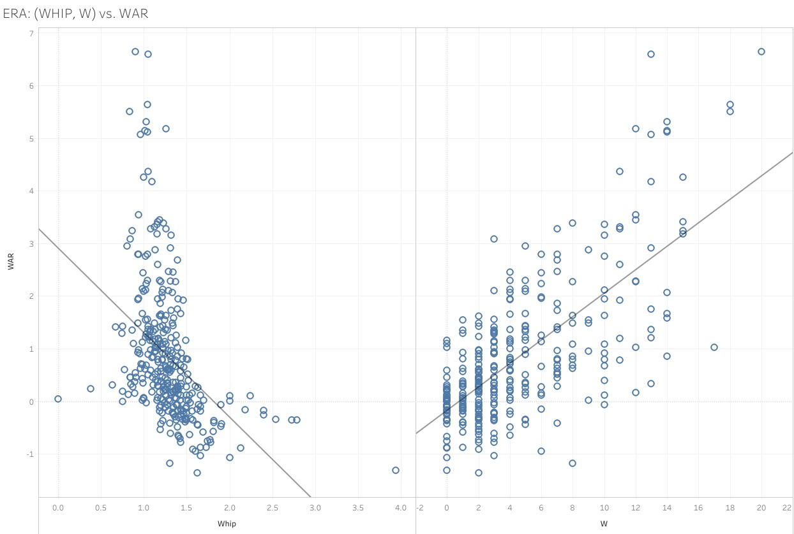

Slide 17
Results
Position Players
Stepwise Regression Effects
RBI, AVG, H: Not Significant
Interpretation of coefficients (Significance Highest to Lowest):
WAR: For each additional win above replacement, the average salary is estimated to increase by approximately $2,626,170.
HR: For each additional home run, the average salary is estimated to increase by approximately $213,328.
AGE: For each additional year in age, the average salary is estimated to decrease by approximately $351,559.
Intercept: The average predicted AVG. SALARY when all other variables are zero is $9,170,388
OPS: The coefficient for OPS is approximately $5,079,409. However, its p-value is 0.08250, which is above the common significance level of 0.05, suggesting that OPS may not be statistically significant in predicting AVG. SALARY in this model.
The adjusted R-squared for this model indicates that the included variables collectively explain about 64.57% of the variability in AVG. SALARY.

Slide 18
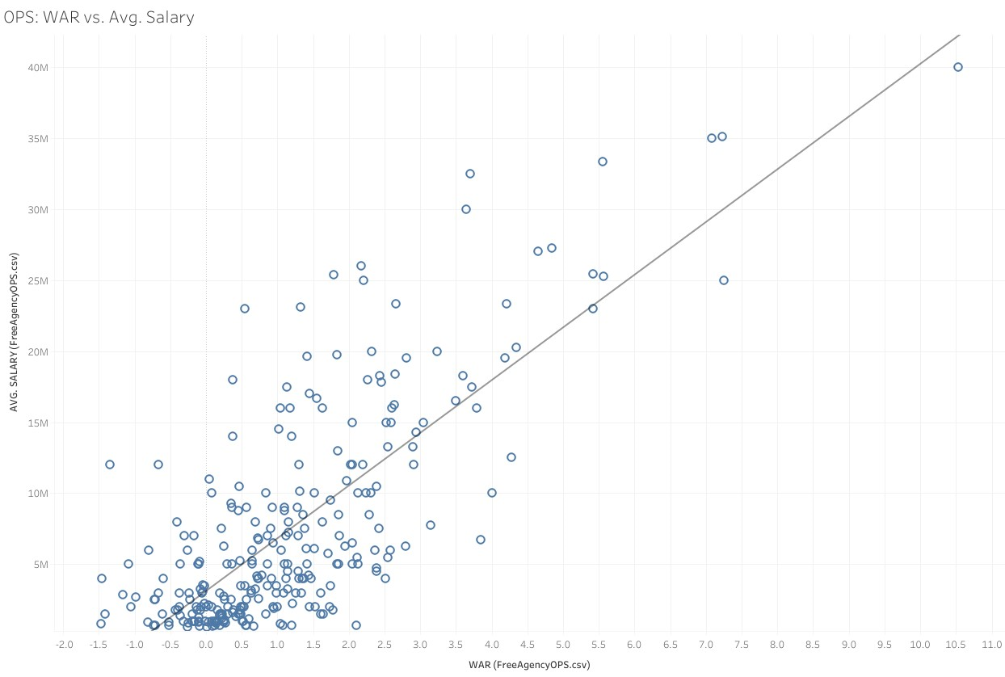
Results
Position Players

Slide 19
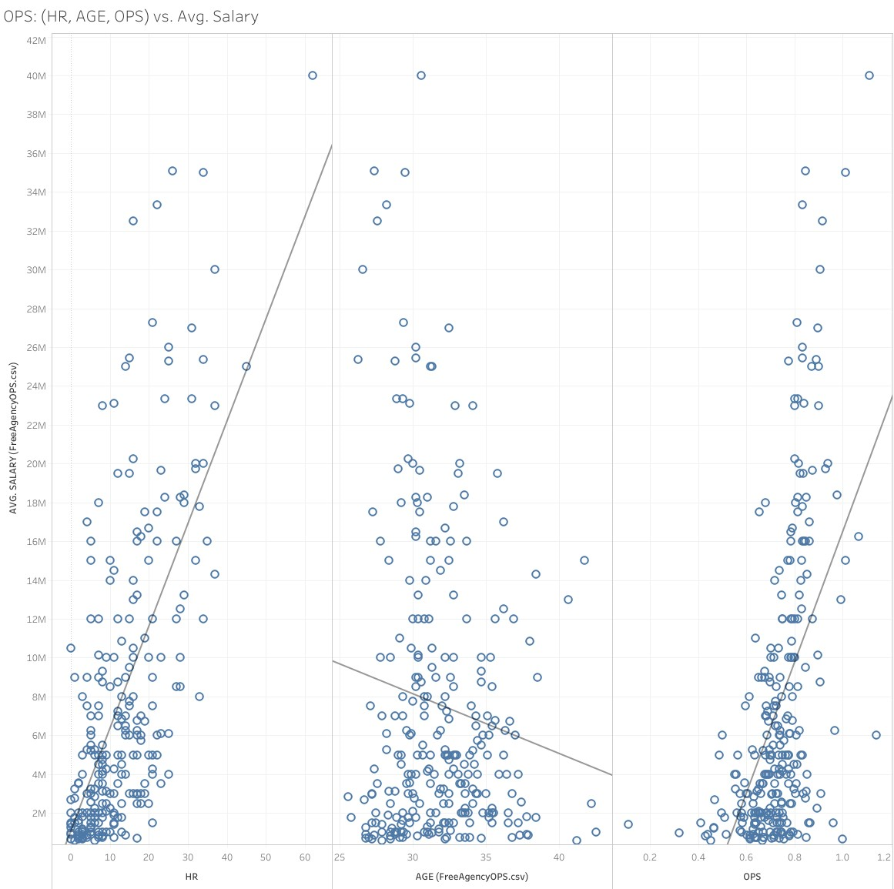

Slide 20
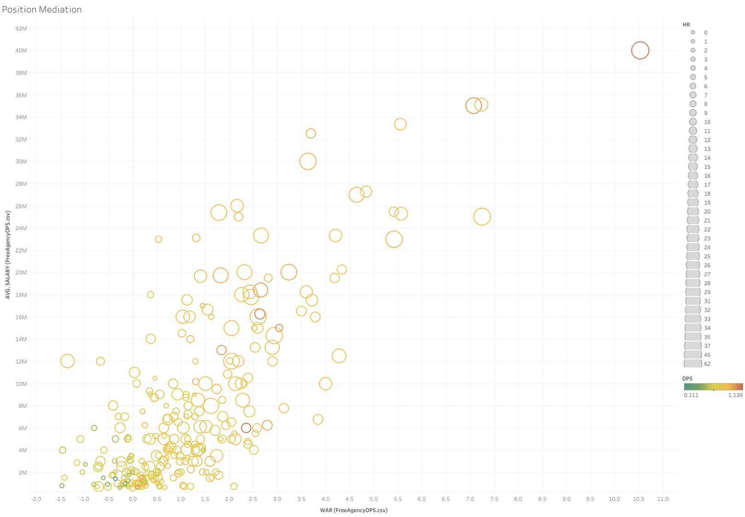
Mediation Analysis
24.8% HR
10.01% OPS

Slide 21
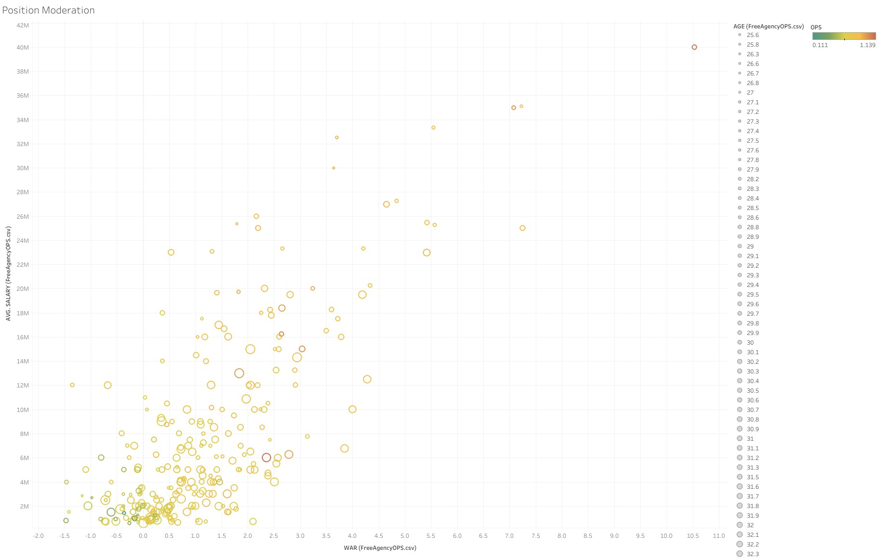
Moderation Analysis
AGE 61.52%
OPS 60.61%
Moderates the relationship between WAR and AVG. SALARY

Slide 22
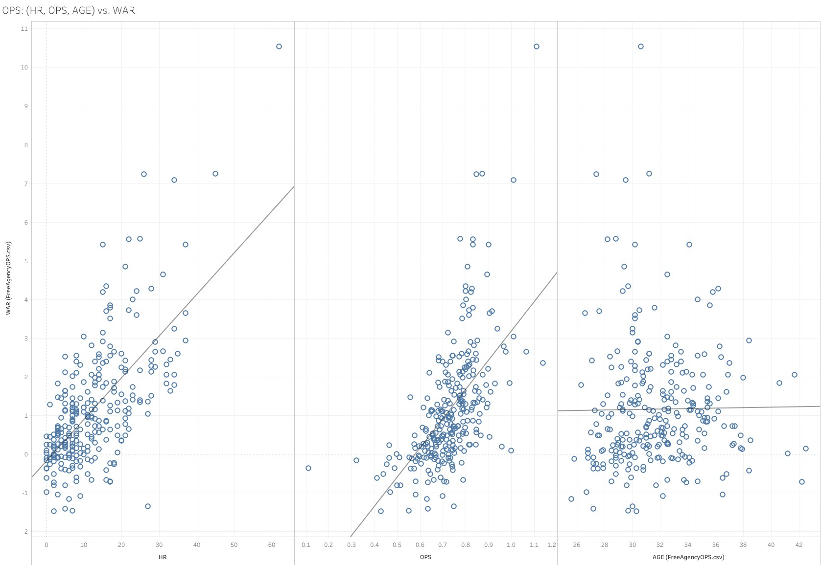

Slide 23
Summary
Pitcher
Y =$15901686 − ($284546*AGE*0.5193) + ($724465*ERA) − ($5699905*WHIP*.4998) + ($533834*W*.3) + ($93039*SV) + ($2310227*WAR)
Yield around % difference
Position Player
Y =$9170388 − ($351559*AGE*.6152) + ($213328*HR*.248) + ($5079409*OPS*.6061) + ($2626170*WAR)
Yields around 128% difference

Slide 24
Conclusions

Slide 25
Questions?

Slide 26
Citations
2024 MLB Free Agents Tracker. (n.d.). Spotrac.com. https://www.spotrac.com/mlb/free-agents/
Standard Stats | Glossary | MLB.com. (n.d.). MLB.com. https://www.mlb.com/glossary/standard-stats
Advanced Stats | Glossary | MLB.com. (n.d.). MLB.com. https://www.mlb.com/glossary/advanced-stats
Ravelo, C. (2022, November 23). Stepwise Regression: What is it and should you use it? Statistics Solutions. https://www.statisticssolutions.com/stepwise-regression-what-is-it-and-should-you-use-it/
Fein, E. C. (2022, June 16). Section 7.3: Moderation Models, Assumptions, Interpretation, and Write up. Pressbooks. https://usq.pressbooks.pub/statisticsforresearchstudents/chapter/moderation-assumptions/

